Slide 1
Online Module
Linking Internal and External Quality Assurance
AQ Austria
Kerstin Schörg

Slide 2
Learning Outcomes of this Online Module
  Recall terms commonly used in quality assurance language
  Understand the basic roles, purposes and characteristics of Quality Assurance
  Summarize the different approaches of External Quality Assurance (EQA)
  Summarize the strengths and limitations of Internal Quality Assurance (IQA)
  Understand the relationship between Quality, EQA and IQA

Slide 3
Terms commonly used in quality assurance language:
Quality assurance (internal and external)
Quality assessment/evaluation
Quality audit
Accreditation
There is no general consensus on the exact meaning of these, some of them are generic for the whole field, such as quality assurance (internal and external) and quality assessment, while others relate to more specific approaches (quality audit and accreditation)
INQAAHE glossary: http://www.qualityresearchinternational.com/glossary/
ECAHE glossary: http://ecahe.eu/w/index.php/Category:Glossary

Slide 4
Quality assurance (QA) is a generic term used as a shorthand for all forms of quality monitoring, evaluation or review.
Internal quality assurance (IQA) refers to each institution’s or program’s policies and mechanisms for ensuring that it is fulfilling its own purposes as well as the standards that apply to higher education in general or to the profession or discipline in particular.
External quality assurance (EQA) refers to the actions of an external body which may be a Quality Assurance Agency or another body different from the institution, which assesses its operation or that of its programs in order to determine whether it is meeting the standards that have been agreed on.
Accreditation is a formal and independent decision indicating that a programme and/or an institution meets certain predefined quality standards

Slide 5
Quality assessment is the evaluation of the quality itself. Assessment tries to collect data, information and evidence of the quality of the higher education institution as a whole (institutional assessment) or its core activities separately (programme assessment). It goes beyond quality procedures (although it will be included) and tries to judge the quality of input, process and output. Assessment does not necessarily lead to a formal accreditation decision. However, formal accreditation needs to be based on assessment.
Audit is the evaluation or review of procedures, processes and mechanism in a higher education institution or a part of such an institution. Not quality itself is subject of review, but procedures and mechanism to assure the quality and the processes to achieve the mission and goals.

Slide 6
What is quality in higher education?
  It is important to raise this question at the beginning of any discussion about quality or quality assurance in higher education
  This discussion is often omitted, especially in more technical discussions or rushed policy debates
  There is no single, universally accepted definition of quality in higher education, but there are different ways to think about quality

Slide 7
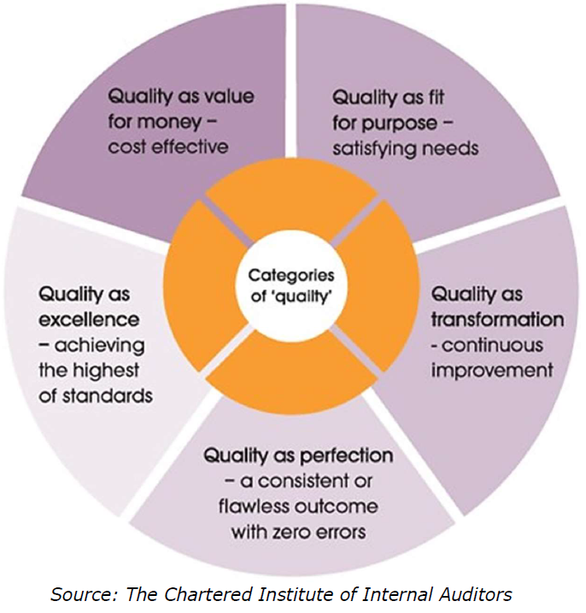
5 ways to think
about quality

Slide 8
5 ways to think about quality
  Quality as exceptional/excellence – this view refers to quality as exceptional with regard to the highest academic standards and excellence. By definition, this kind of quality is not attainable by all.
  Quality as perfection or consistency – this approach looks at quality as a process to eliminate defects and aiming for a consistent or flawless outcome. In this view, quality can be attained by all by focusing on consistency (constantly improving and eliminating flaws).
  Quality as fitness for purpose – in this view quality is measured by the level of fulfillment of a stated purpose, mission or goals - either by an institution or an academic program; the exact meaning will vary depending on the actual purpose envisioned.

Slide 9
5 ways to think about quality
  Quality as value for money – the focus here is on the output per input ratio, with the aim of gaining more efficiency. In other words, this is similar to a return on investment approach. Quality is attained when a better or higher outcome can be achieved at the same cost, or if the cost can be decreased while the outcome level is maintained.
  Quality as transformation – this approach looks learning that is centered on the student; views quality as value-added and transformation and empowerment of a student through the learning process. In this scheme, quality is achieved when the learning proves transformative for the student.

Slide 10
What is quality in higher education?
The most common views about quality in the European Higher Education Area (EHEA):
Fitness for purpose
Continuous improvement
Quality is a moving target: it can be approached, but never completely achieved. The main goal is to focus on continuous improvement.

Slide 11
What is quality in higher education?
  “Quality in higher education is a bit like love: not tangible, yet present. You can experience it, yet not quantify it. It remains fleeting, so you have to consistently and repeatedly engage with it.”
  (Müller-Böling, 1997)

Slide 12
Responsibility for QA
  „Consistent with the principle of institutional autonomy, the primary responsibility for quality assurance in higher education lies with each institution itself and this provides the basis for real accountability of the academic system within the national quality framework (Berlin Communiqué, 2003)

Slide 13
Roles and Purposes of Quality Assurance
Accountability
Control
Compliance
Improvement
/Enhancement
  Ensuring the integrity of the higher education sector, in particular making it difficult for poor or rogue providers to continue operating and making access to the sector dependent on the fulfilment of criteria of adequacy.
  Institutions taking responsibility for the service they provide and the public money they spend.
  Ensuring that institutions adopt procedures, practices and policies considered by funders, governments, and professional bodies to be desirable for the proper conduct of the sector and to ensure its quality.
  Less about constraint and more about the encouragement of adjustment and change.
Primary but not only EQA
Primary but not only IQA

Slide 14
EQA
(external) Standards & Criteria
Benchmark for the Assessment
IQA
Mission, Vision of the HEI

Slide 15
Basic Characteristics of EQA and IQA
Characteristics | External QA | Internal QA
Objective | Accountability & Compliance | Improvement & Enhancement
Authority | Legislative | Administrative
Nature of Regulations | Universal application | Local application
Control/Management | Government (Agency) | HEI
Level of operation | National Level | Institutional Level
Nature of report | Public | Private

Slide 16
Primary function of External Quality Assurance
  The primary function of External Quality Assurance is regulatory, ensuring that the quality is being maintained in expanding systems of higher education, as new provicers join established universities.
  In many cases it is the EQA requirements that are the driving force behind the shaping of IQA, in order to satisfy the external requirements of an authorative regulatory body.

Slide 17
Approaches of EQA
Activity | Question | Emphasis | Outcome
Accreditation | Are you good enough to be approved? | Comprehensive (mission, resources, processes) | Yes/No, Pass/Fail
Assessment / Evaluation | How good are your outputs? | Outputs | Grade (including Pass/Fail)
Audit / Review | Are you achieving your own objectives? Are your processes effective? | Processes | Description, qualitative

Slide 18
Internal Quality Assurance (IQA)
  Internal Quality Assurance (IQA) refers to all kinds of policies, activities and mechanisms related to evaluation and improvement of quality, and developed and carried out by and within higher education institutions. University approaches to IQA are considered as more improvement-oriented, and they tend to focus more on the quality of teaching and learning aspects and the concept of organizational quality culture. Among experts, it is the IQA systems that are considered key to effective and successful Quality Assurance process.

Slide 19
External perspectives within IQA
“Internal” does not mean that only perspectives of the HEI itself should be considered within IQA processes
Effective self-evaluation has to draw on a range of perspectives beyond those of teachers, students are clearly central to the evaluation process as well
External perspectives brought in by academics from other departments and/or institutions can introduce greater objectivity and contrasting experiences
Even though separate EQA assessments may be taking place, it is generally desirable for IQA processes to include some external perspectives e.g. the perspectives of employers

Slide 20
Strengths of IQA
HEIs has the capacity to initiate all decisions and determine which fields to be evaluated
Easier to integrate internal quality assurance strategies with institutional strategy to ensure better results
Absence of standardized evaluation methods promotes the flexibility of internal quality system, and creates better room for the independent mangers to adjust to changes in the immediate environment of the institution at the appropriate time
Finally, internal quality systems make room for choice. That is, processes could be easily varied to suit the institution's desired quality assurance approach.

Slide 21
Effectiveness of IQA
Whether improvement can be achieved or not depends on various factors:
Internal management
Organizational structure
The response to the requirements of EQA agencies and
The interests pursued by the internal stakeholders.
IQA can be both – a conservative, conformist force and an innovative, transformative one.

Slide 22
Possible limitations of/threats to the effectiveness of IQA
  The focus of IQA is often the attempt to obtain a good rating from the EQA process → “culture of compliance” in which universities adopt highly visible but superficial mechanisms to impress external evaluators
  Risk of managerialism = excessive emphasis on management practices without a corresponding prioritization of academic issues
  Focus on data and data gathering without a clear objective in mind
  Rapid or continual change in the design of national policies regarding QA
  Discouragement by quality assurance systems which apply mostly prescriptive, quantitative or formal standards, thus emphasizing compliance.

Slide 23
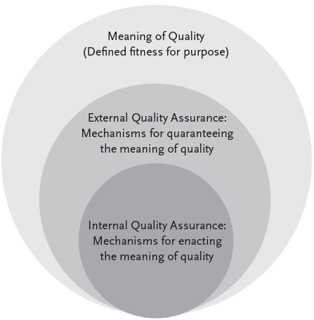
Relationship between Quality, EQA and IQA
  Quality in higher education is best defined as fitness for purposes, which is the result of a negotiated settlement among key stakeholders including the funders, users of the products/programs, users of outputs, and employees of the institutions.
  This implies that external quality assurance and internal quality assurance have to move along with the changing meaning of quality as a result of changing trends in higher education.
  Activities of external quality assurance affect internal quality assurance, and the opposite is true as well. The implication is that constant negotiations and settlements are necessary for effective implementation of quality assurance in higher education.
Source: Ansah, 2016

Slide 24
How does EQA impact the development of IQA
  EQA can establish standards for IQA
  EQA can make recommendations for IQA
  EQA systems can trigger new data collection for IQA but
  EQA can also have negative effects on IQA, when it reduces the internal ownership of quality processes and produces a “culture of compliance”

Slide 25
How does IQA impact the development of EQA
  In many cases the development of IQA systems has been a direct reaction to EQA processes but IQA is not only about compliance with EQA requirements
  As improvement comes from within but EQA systems also claim to foster improvement, EQA has to watch the developments of IQA closely in order to react appropriately
  This can be seen in the development of different EQA approaches → Quality Audit trying to answer the questions „Are you achieving your own objectives? Are your processes effective?”

Slide 26
Relationship between Quality, EQA and IQA
  Without a settled meaning of quality, external quality assurance and internal quality assurance have no practical relevance, because their only function is to guarantee and enact the meaning of quality.
  External and internal quality assurance are considered complementary concepts, which require negotiation and settlement to address any tensions that affect effective implementation in higher education.
  External and internal quality assurance can be considered as two sides of the same coin – you need both in order to fulfil all the roles and purposes of QA

Slide 27
Sources
  Making basic choices for external quality assurance systems – Modul 1, UNESCO IIEP
  https://unesdoc.unesco.org/ark:/48223/pf0000182478
  Quality Assurance in Higher Education: A Practical Handbook, Central European University, Yehuda Elkana Center for Higher Education Budapest, Hungary, 2016
  https://elkanacenter.ceu.edu/sites/elkanacenter.ceu.edu/files/attachment/basicpage/57/qahandbook.pdf
  Conceptualising External and Internal Quality Assurance in Higher Education: A Pragmatist Perspecitve, Francis Ansah, 2016
  https://www.researchgate.net/publication/299128977_Conceptualising_External_and_Internal_Quality_Assurance_in_Higher_Education_A_Pragmatist_Perspective

Slide 28
Sources
  Linking External and Internal Quality Assurance, IIEP Policy Brief
  https://unesdoc.unesco.org/ark:/48223/pf0000263247
  Quality and Employability in Higher Education: Viewing Internal Quality Assurance as a Lever for Change, UNESCO IIEP
  https://unesdoc.unesco.org/ark:/48223/pf0000366688?posInSet=1&queryId=b74a7aa5-9f1c-4239-bfc7-bfb5567565b2

